Slide 1

HSE UNIVERSITY
OPTIMIZATION METHODS · SEMINAR 01
OPTIMIZATION METHODS
Derivative checks
local geometry and regression
Seminar 01
Anna Matveeva
Telegram: @moomive
07/09
1

Slide 2
HSE UNIVERSITY
OPTIMIZATION METHODS · SEMINAR 01
Today we will build a derivative-testing workflow
The goal is not only to derive formulas, but to trust the implementation that uses them.
1
Translate
scalar objective → vectorized NumPy code
5
2
Differentiate
quadratic · MSE · logistic losses
checks before you trust an objective function
3
Classify
stationary points via Hessian eigenvalues
4
Verify
central differences and directional checks
5
Debug
shape · sign · scaling · stability bugs
seminar goals
A gradient is not finished when it is derived —
it is finished when it passes an independent check.
TAKEAWAY
2

Slide 3
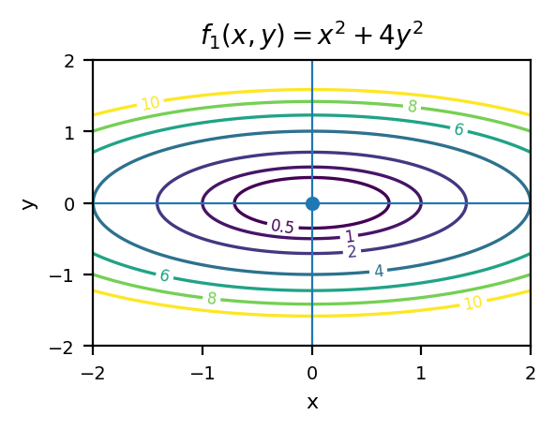
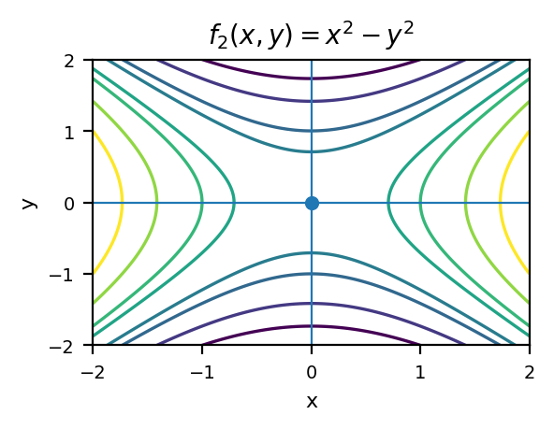
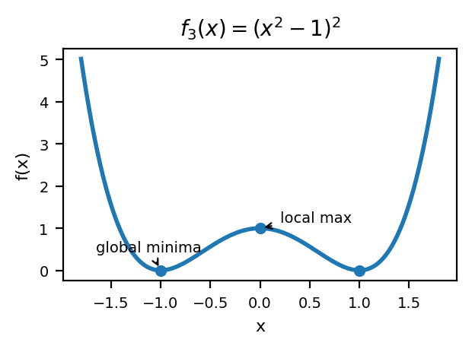
HSE UNIVERSITY
OPTIMIZATION METHODS · SEMINAR 01
Warm-up — read the geometry before differentiating
Before taking derivatives, predict where stationary points are and what type they might be.
Elliptic contours around
a single minimum at (0,0)
Hyperbolic contours:
the origin is a saddle point
Two minima at x = ±1 and
a local maximum at x = 0
QUESTION
Which information is supplied by the gradient, and which by the Hessian?
3

Slide 4
HSE UNIVERSITY
OPTIMIZATION METHODS · SEMINAR 01
Shapes are part of the mathematics
Correct derivatives start with a consistent convention for vectors, matrices and array shapes.
X ∈ ℝⁿˣᵈ · w ∈ ℝᵈ · y ∈ ℝⁿ · Xw ∈ ℝⁿ
X.shape # (n, d)
w.shape # (d,)
y.shape # (n,)
(X @ w).shape # (n,)
Broadcasting
Multiplication order
BUG 1
BUG 2
Accidental (n,1) arrays can silently change the computation.
X @ X.T is not the same object
as X.T @ X.
Scaling
Operator choice
BUG 3
BUG 4
Do not sum the loss and differentiate its mean.
Elementwise * and matrix @ are not interchangeable.
TAKEAWAY
If the shapes are wrong, the calculus result is irrelevant — debug dimensions first.
4

Slide 5
HSE UNIVERSITY
OPTIMIZATION METHODS · SEMINAR 01
Differentials give a repeatable derivation recipe
Use the same five-step routine every time you derive a vector gradient.
1
2
3
4
5
Write df using product and chain rules
Move every dx to the final position
Rewrite df as an inner product ⟨g, dx⟩
Read off g = ∇f(x)
Check that shape(g) matches shape(x)
USEFUL IDENTITIES
d(Ax) = A dx · d(xᵀy) = yᵀdx + xᵀdy · d(xᵀAx) = ⟨(A+Aᵀ)x, dx⟩
WHY THIS HELPS
It avoids coordinate-wise expansion and makes matrix calculus systematic.
5

Slide 6
HSE UNIVERSITY
OPTIMIZATION METHODS · SEMINAR 01
Exercise 1 — derive a quadratic gradient
Use differentials, not coordinate-by-coordinate expansion.
OBJECTIVE
1
Find ∇f(x) without assuming that A is symmetric.
2
Find the Hessian Hf(x).
3
Which part of A actually influences xᵀAx?
4
When is the stationary point unique?
Hint: the quadratic form depends only on the symmetric part of A.
6

Slide 7
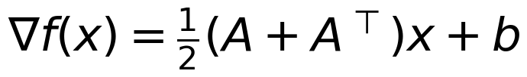
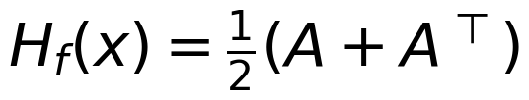

HSE UNIVERSITY
OPTIMIZATION METHODS · SEMINAR 01
Exercise 1 — solution and implementation
The skew-symmetric part disappears; only the symmetric part matters.
GRADIENT
HESSIAN
KEY FACT
INTERPRETATION
STATIONARY POINT
UNIQUENESS OF MINIMIZER
Only ½ (A + Aᵀ) matters
Solve ½ (A+Aᵀ) x + b =0
Need positive definiteness
The antisymmetric part cannot change the scalar value xᵀAx.
Uniqueness needs the symmetric part to be nonsingular.
If ½(A+Aᵀ) ≻ 0, the quadratic has a unique global minimizer.
def quadratic_value(x, A, b, c=0.0):
return 0.5*x @ A @ x + b @ x + c
def quadratic_grad(x, A, b):
return 0.5*(A + A.T) @ x + b
def quadratic_hessian(A):
return 0.5*(A + A.T)
7

Slide 8
HSE UNIVERSITY
OPTIMIZATION METHODS · SEMINAR 01
A Hessian classifier needs tolerance, not exact zero
Numerical eigenvalues should be interpreted with a tolerance and with explicit symmetrization.
CASE 1
All eigenvalues > tol
Strict local minimum.
def classify_hessian(H, tol=1e-8):
eig = np.linalg.eigvalsh(0.5*(H + H.T))
if np.all(eig > tol):
return "strict local minimum"
if np.all(eig < -tol):
return "strict local maximum"
if eig.min() < -tol and eig.max() > tol:
return "saddle point"
return "second-order test is inconclusive"
CASE 2
All eigenvalues < −tol
Strict local maximum.
CASE 3
Mixed signs
Saddle point.
CASE 4
Near-zero eigenvalues remain
Second-order test is inconclusive.
WHY eigvalsh?
Because the Hessian should be symmetric and real; eigvalsh is the right routine for that.
8

Slide 9
HSE UNIVERSITY
OPTIMIZATION METHODS · SEMINAR 01
Exercise 2 — classify four stationary points
Use derivatives up to second order. If the Hessian is inconclusive, inspect the function directly.
01
02
f₁(x, y) = x² + 2y²
f₂(x, y) = x² − y²
Positive definite Hessian.
Indefinite Hessian.
03
04
f₃(x, y) = x⁴ + y⁴
f₄(x, y) = x³ + y²
Flat Hessian at the origin.
Semidefinite Hessian; check a direction.
For f₃ and f₄, the Hessian does not tell the full story.
You must inspect signs along carefully chosen directions.
9

Slide 10
HSE UNIVERSITY
OPTIMIZATION METHODS · SEMINAR 01
Exercise 2 — what the Hessian can and cannot decide
The Hessian detects curvature, but flat directions may require a direct argument.
FUNCTION
∇f(0)
Hf(0)
CONCLUSION
x² + 2y²
0
diag(2,4)
strict minimum
x² − y²
0
diag(2,−2)
saddle point
x⁴ + y⁴
0
0
minimum; test inconclusive
x³ + y²
0
diag(0,2)
saddle; test inconclusive
IMPORTANT DIRECTION FOR f₄
Set y = 0, then f₄(x,0) = x³
This takes both positive and negative values near 0, so the origin is a saddle point.
TAKEAWAY
A semidefinite Hessian may leave flat directions unresolved; then use the definition or inspect special directions.
10

Slide 11
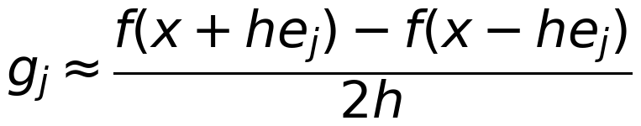
HSE UNIVERSITY
OPTIMIZATION METHODS · SEMINAR 01
Central differences independently estimate gradients
The checker must be independent from the analytic gradient implementation.
NUMERICAL IDEA
def finite_difference_grad(f, x, h=1e-5):
x = np.asarray(x, dtype=float)
g = np.empty_like(x)
for j in range(x.size):
step = np.zeros_like(x); step[j] = h
g[j] = (f(x+step)-f(x-step))/(2*h)
return g
def relative_error(g, g_ref):
return np.linalg.norm(g-g_ref) /
(1 + np.linalg.norm(g) + np.linalg.norm(g_ref))
TEST POINTS
Use random non-special points
A gradient that passes at x=0 may still fail elsewhere.
ERROR METRIC
Use a relative error
The denominator prevents tiny vectors from misleading the comparison.
GOOD PRACTICE
Check several points and several h values, not just one.
11

Slide 12
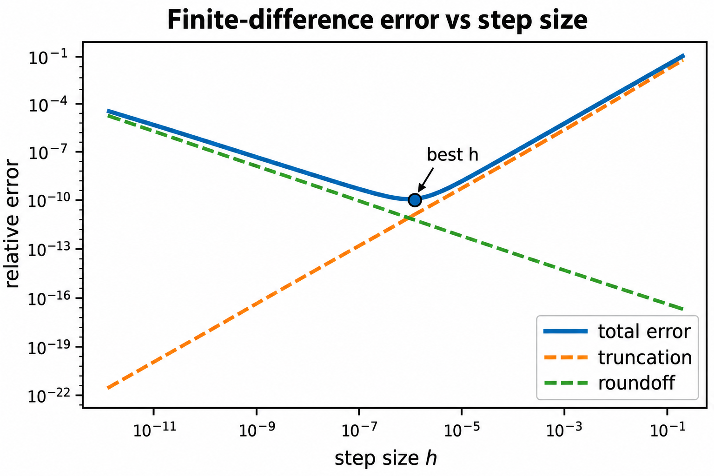
HSE UNIVERSITY
OPTIMIZATION METHODS · SEMINAR 01
The step-size experiment reveals two sources of error
The best h balances truncation error against floating-point roundoff.
LARGE h → truncation
Finite differences are only local approximations
If h is too large, the slope estimate is biased.
SMALL h → roundoff
Subtraction of nearly equal numbers amplifies noise
If h is too small, floating-point error dominates.
BEST REGION
Choose h near the bottom of the U-shaped curve
The optimal h is problem- and scale-dependent.
Why is the smallest available h not the best choice?
QUESTION
12

Slide 13
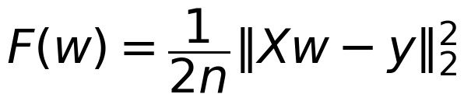
HSE UNIVERSITY
OPTIMIZATION METHODS · SEMINAR 01
Linear regression — derive before you code
Make the objective, gradient and Hessian explicit before implementing MSE.
OBJECTIVE
w
→
Xw
→
r = Xw − y
→
F(w) = ½n⁻¹ ‖r‖²
→
∇F(w), H_F(w)
parameters
prediction
residual
scalar loss
derivatives
1
Derive ∇F(w) and H_F(w).
2
Identify the dimensions of every intermediate vector.
3
State a condition for a unique minimizer.
4
Derive the ridge-regularized gradient.
EXPECTED RESULT
13

Slide 14
HSE UNIVERSITY
OPTIMIZATION METHODS · SEMINAR 01
Keep the loss and gradient consistent
The loss definition determines the scaling of the gradient and the Hessian.
def mse_loss(w, X, y, l2=0.0):
residual = X @ w - y
return 0.5*np.mean(residual**2) +
0.5*l2*(w @ w)
IF LOSS USES A SUM
Drop the division by n in the gradient and Hessian
The scaling must match the objective exactly.
def mse_grad(w, X, y, l2=0.0):
n = X.shape[0]
residual = X @ w - y
return X.T @ residual / n + l2*w
RIDGE REGULARIZATION
If the penalty is (λ/2)||w||², then the gradient adds λw
def mse_hessian(X, l2=0.0):
n, d = X.shape
return X.T @ X / n +
l2*np.eye(d)
Use the same λ convention everywhere.
14

Slide 15
HSE UNIVERSITY
OPTIMIZATION METHODS · SEMINAR 01
Coding task — build a reproducible synthetic problem
Use a fixed seed and explicit dimensions so everyone debugs the same example.
1
Check mse_grad at five random parameter vectors.
rng = np.random.default_rng(42)
n, d = 200, 8
X = rng.normal(size=(n, d))
w_true = rng.normal(size=d)
y = X @ w_true + 0.2*rng.normal(size=n)
w0 = rng.normal(size=d)
2
Report the maximum relative error.
3
Solve the normal equations with np.linalg.solve.
4
Compare w* with w_true.
5
Inspect the smallest and largest Hessian eigenvalues.
WHY THIS MATTERS
A reproducible synthetic problem turns debugging from guesswork into an experiment.
15

Slide 16
HSE UNIVERSITY
OPTIMIZATION METHODS · SEMINAR 01
Solve normal equations without an inverse
Avoid explicit inversion; use linear solves or least-squares factorization.
AVOID
w_star = np.linalg.inv(X.T @ X) @ X.T @ y
Explicit inversion is less stable and usually unnecessary.
PREFER
A = X.T @ X · b = X.T @ y · w_star = np.linalg.solve(A, b)
This solves the system directly.
OR FACTORIZE
w_star, *_ = np.linalg.lstsq(X, y, rcond=None)
This remains meaningful when XᵀX is singular or nearly singular.
GOOD RULE
If you find yourself writing inv(A) @ b, stop and rethink the computation.
16

Slide 17
HSE UNIVERSITY
OPTIMIZATION METHODS · SEMINAR 01
Experiment — rank deficiency breaks uniqueness
Duplicate features leave the loss convex but destroy uniqueness of the minimizer.
X_bad = np.column_stack([X, X[:, 0]])
H_bad = X_bad.T @ X_bad / len(X_bad)
print(np.linalg.eigvalsh(H_bad))
CONVEXITY
UNIQUENESS
Yes, the loss is still convex
No, the minimizer is not unique
X_badᵀX_bad remains positive semidefinite.
There is a zero-curvature direction corresponding to the duplicated feature.
PREDICTIONS
RIDGE FIX
Different parameter vectors can make identical predictions
Adding λI makes the Hessian positive definite
Only the fitted outputs X_bad w matter.
Then the ridge objective has a unique minimizer.
TAKEAWAY
Rank deficiency is not just a linear-algebra curiosity — it changes the geometry of learning.
17

Slide 18
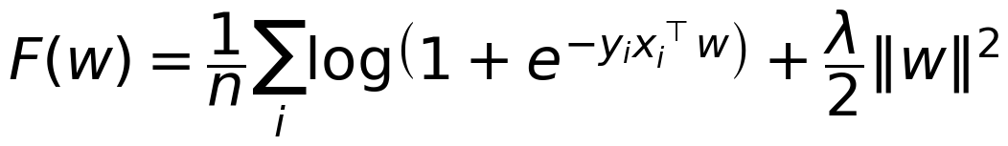
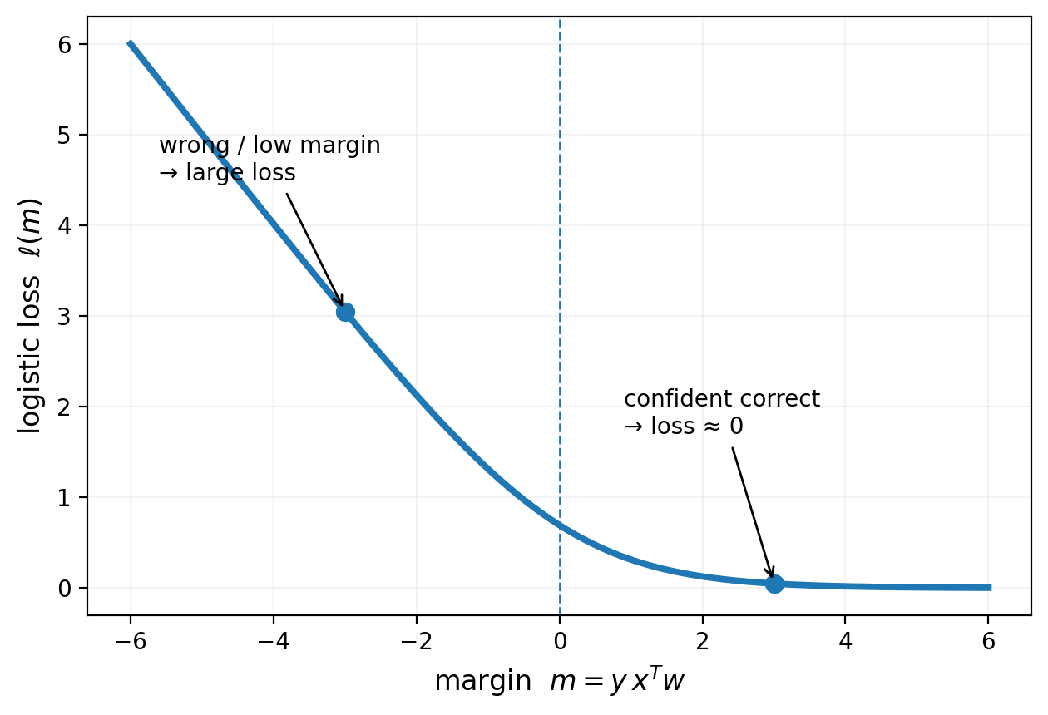
HSE UNIVERSITY
OPTIMIZATION METHODS · SEMINAR 01
Logistic loss needs both calculus and stable code
Correct formulas are only half the battle; the implementation must also remain numerically stable.
OBJECTIVE
def logistic_loss(w, X, y, l2=0.0):
margin = y * (X @ w)
return (np.mean(np.logaddexp(0.0, -margin))
+ 0.5*l2*(w @ w))
LOGISTIC LOSS VS MARGIN
def logistic_grad(w, X, y, l2=0.0):
margin = y * (X @ w)
weights = -y / (1.0 + np.exp(margin))
return X.T @ weights / X.shape[0] + l2*w
STABILITY NOTE
np.logaddexp is preferred because log(1 + exp(z)) can overflow for large z.
18

Slide 19
HSE UNIVERSITY
OPTIMIZATION METHODS · SEMINAR 01
Exercise 3 — find the bugs without running the code
Several conceptual mistakes are hiding in just a few lines.
BUG 1
def broken_grad(w, X, y, l2):
margin = y * X @ w
weights = y / (1 + np.exp(-margin))
return X @ weights + 2*l2*w
Operator precedence in the margin.
BUG 2
Wrong sign and wrong sigmoid argument.
BUG 3
Matrix dimensions are inconsistent.
BUG 4
Mean-versus-sum scaling is missing.
BUG 5
Regularizer convention does not match λ/2‖w‖².
PRACTICE
Try to explain each bug in words, not just by editing the code.
19

Slide 20
HSE UNIVERSITY
OPTIMIZATION METHODS · SEMINAR 01
Exercise 3 — one consistent correction
A correct gradient should match the objective, the array shapes and the scaling convention.
def logistic_grad(w, X, y, l2):
margin = y * (X @ w)
weights = -y / (1.0 + np.exp(margin))
return X.T @ weights / X.shape[0] + l2 * w
TEST 1
TEST 2
TEST 3
Extreme margins
λ = 0
Non-square X
Detect instability and sign mistakes.
Check the unregularized case separately.
Shape bugs often appear only away from square matrices.
RULE
A single random test is not enough — include edge cases that target specific failure modes.
20

Slide 21
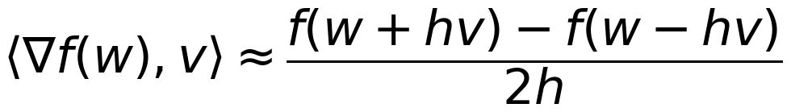
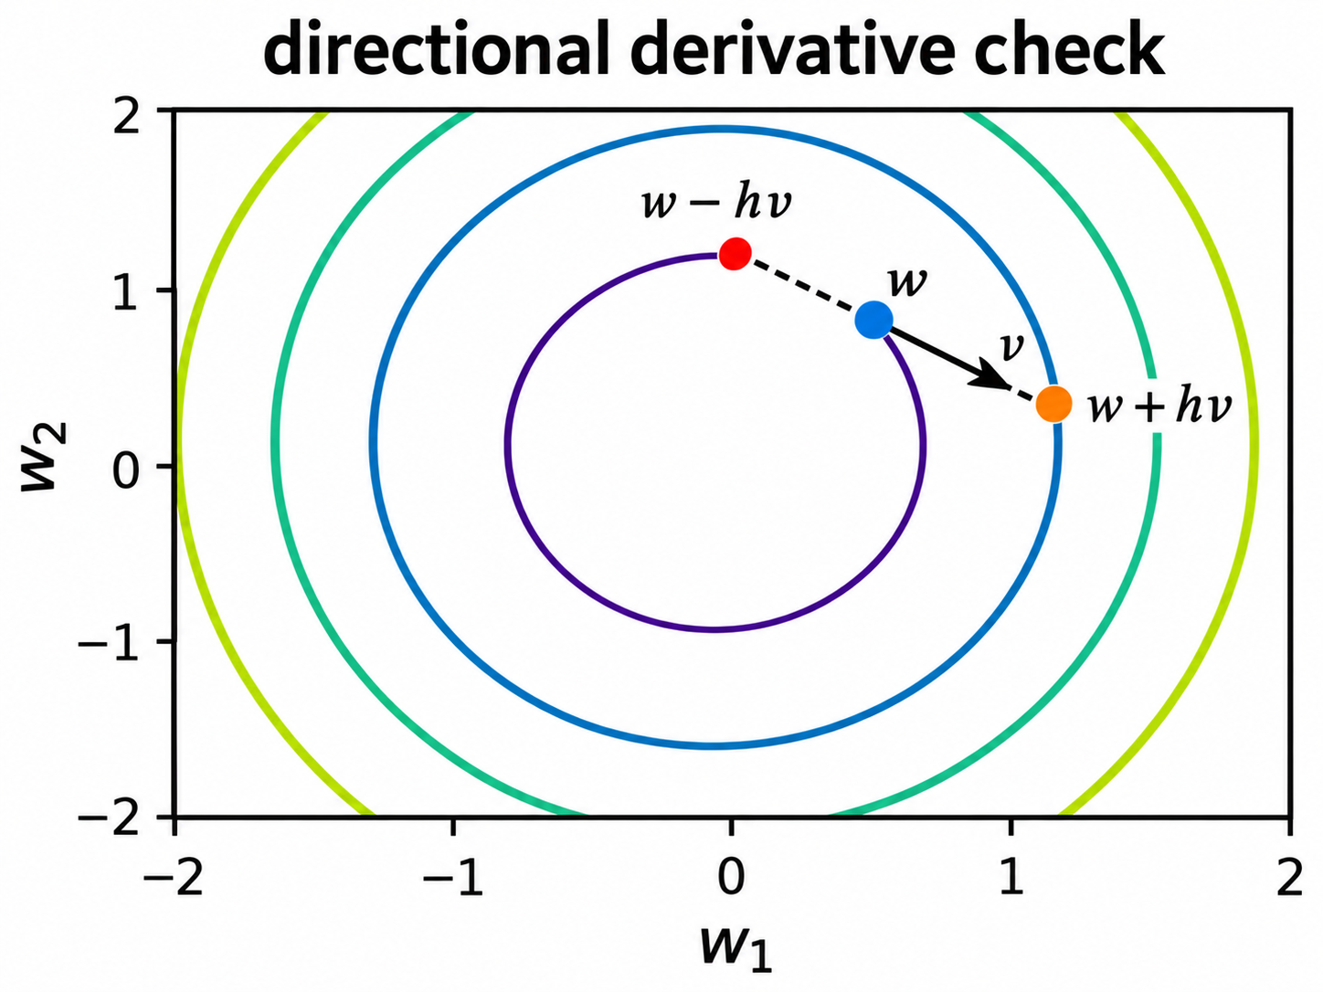
HSE UNIVERSITY
OPTIMIZATION METHODS · SEMINAR 01
Directional checks scale to large models
When d is large, full coordinate-wise finite differences may be too expensive.
DIRECTIONAL CHECK
GEOMETRIC VIEW
COST
Only two function evaluations
def directional_check(f, grad, w, rng, h=1e-5):
v = rng.normal(size=w.shape)
v /= np.linalg.norm(v)
analytic = grad(w) @ v
numeric = (f(w+h*v)-f(w-h*v))/(2*h)
return analytic, numeric
Compared with 2d evaluations for a full coordinate check.
LIMITATION
One direction is not enough
Use several random directions for stronger coverage.
WHEN TO USE
Directional checks are a practical compromise for high-dimensional or expensive objectives.
21

Slide 22
HSE UNIVERSITY
OPTIMIZATION METHODS · SEMINAR 01
Mini-lab — build a gradient audit report
Compare multiple objectives using the same diagnostic template.
OBJECTIVE
DIM
h
RELATIVE ERROR
STATUS
Quadratic
MSE
Logistic
01
At least three values of h.
At least five random points per objective.
02
03
04
One deliberately broken gradient.
A fixed random seed and explicit tolerance.
22

Slide 23
HSE UNIVERSITY
OPTIMIZATION METHODS · SEMINAR 01
A robust implementation separates responsibilities
Independent components are easier to test, debug and reuse.
01
02
03
value(w,data)
grad(w,data)
finite_difference_grad
compute only the scalar objective
compute only the analytic gradient
independent diagnostic
04
05
06
validate_shapes
tests
experiment code
reject malformed inputs early
combine random points and edge cases
record seeds, h values and errors
QUESTION
Why should the finite-difference checker not reuse intermediate values from the analytic gradient?
23

Slide 24
HSE UNIVERSITY
OPTIMIZATION METHODS · SEMINAR 01
Exit ticket — explain these three failures
The best debugging habit is to infer the likely bug before rewriting the code.
01
02
03
The error is large for h = 10⁻³ and 10⁻⁵, but not for h = 10⁻¹
The gradient passes at w = 0 but fails at random w
Analytic and numerical gradients differ by a constant factor n
Likely cause: a sign or scaling bug that is not cured by smaller h.
Likely cause: special cancellations at zero hide the real bug.
Likely cause: sum/mean inconsistency in the objective or gradient.
Most gradient bugs are not advanced-calculus errors - they are signs, shapes, scaling or unstable formulas.
TAKEAWAY
24

Slide 25
HSE UNIVERSITY
OPTIMIZATION METHODS · SEMINAR 01
Five questions every objective must answer
Use this checklist before trusting an implementation in optimization or machine learning.
1
What mathematical objective is implemented?
2
What are the shapes of every variable and every output?
3
Does the analytic gradient agree with finite differences?
4
What does the Hessian say about local geometry?
5
Does the implementation remain stable on extreme inputs?
NEXT SEMINAR
Trusted derivatives become an iterative optimization algorithm.
25

Slide 26
NEXT
Gradient-based optimization
Before next time, make sure you can explain:
• matrix differential recipe
• Hessian classification
• central and directional checks
• rank deficiency
• stable logistic loss
HSE UNIVERSITY · OPTIMIZATION METHODS · SEMINAR 01
2026

